Slide 1
Computer Graphics:
3D viewing Pipeline and PROJECTIONS
Notes:
Need to include coordinate transform and hierarchical modeling

Slide 2
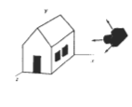
3D-Viewing-Pipeline
The steps for computer generation of a view of 3D scene are analogous to the process of taking photograph by a camera.
For a snapshot, we need to position the camera at a particular point in space and then need to decide camera orientation. Finally when we snap the shutter, the seen is cropped to the size of window of the camera and the light from the visible surfaces is projected into the camera film.

Slide 3
Cont’d
The movement of the object is called a modeling transformation.
The movement of the camera is called a viewing transformation.
The conversion from 3D to 2D is called a projection transformation.
The 2D picture plane, which is mapped to the screen viewport, called a viewport transformation

Slide 4
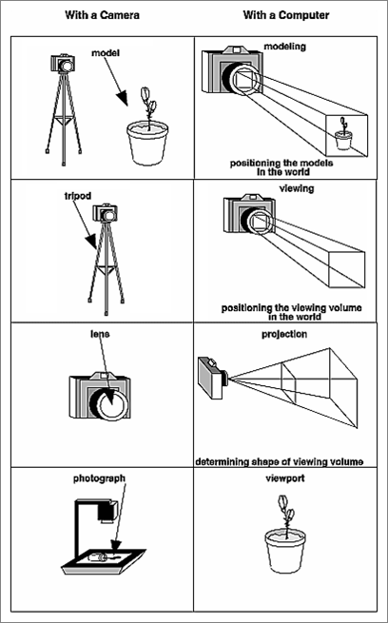
The Camera Analogy
Camera
OpenGL
Modeling: | position model | position model
Viewing: | position camera | position viewing volume
Projection: | choose lens | choose vv shape
Viewport: | choose photo size | choose portion of screen

Slide 5
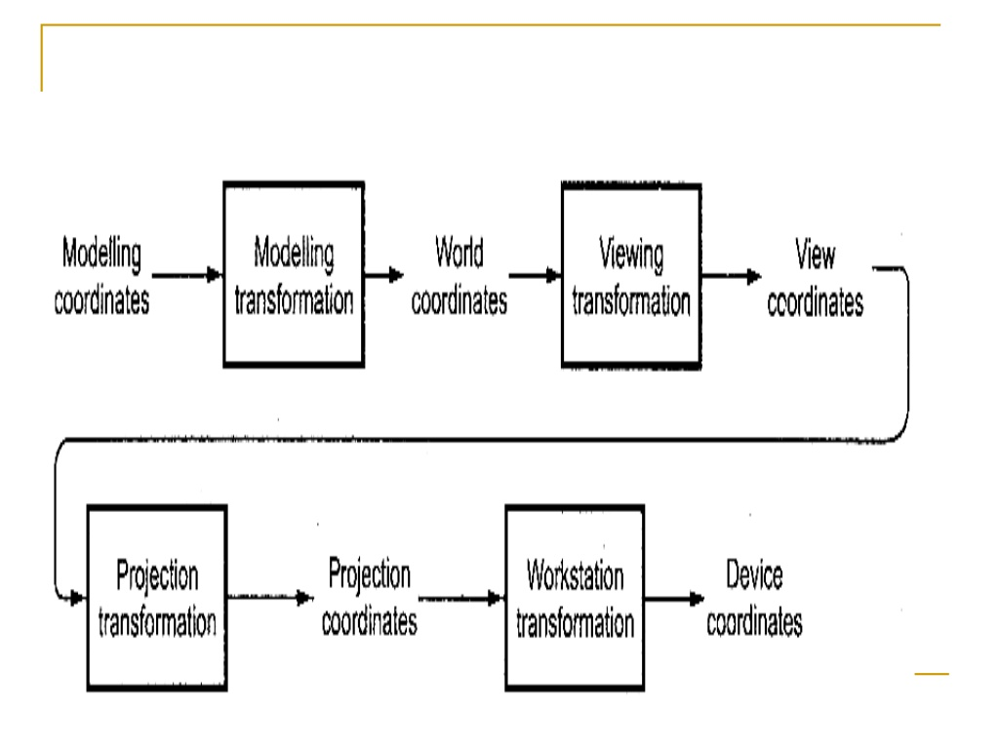


Slide 6
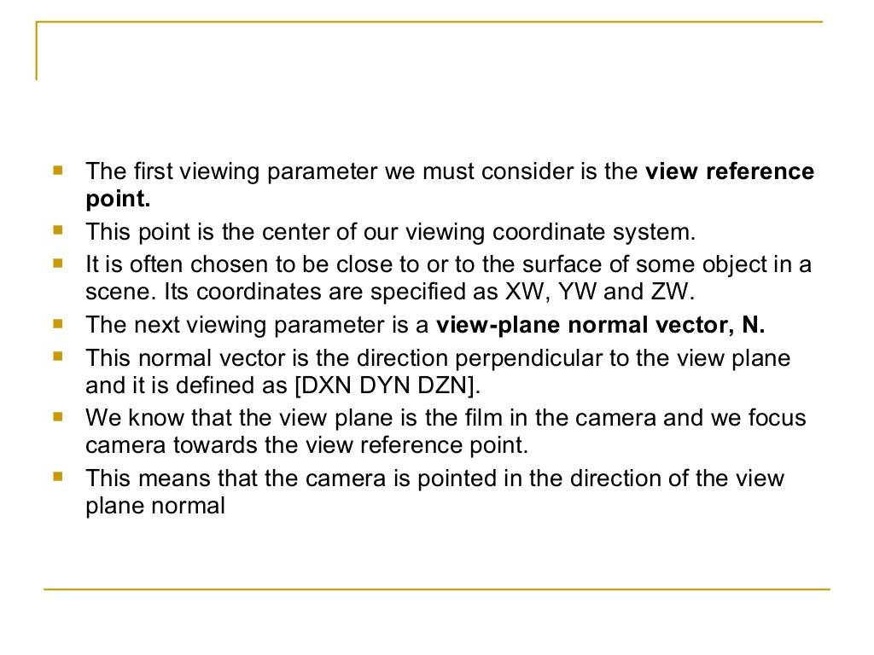

Slide 7
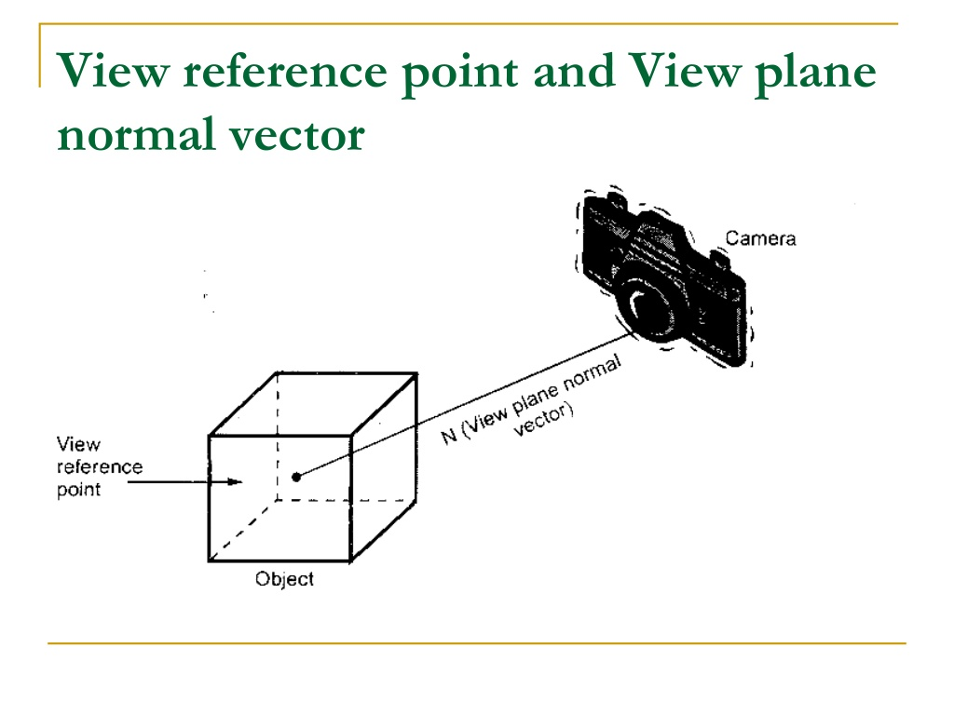

Slide 8
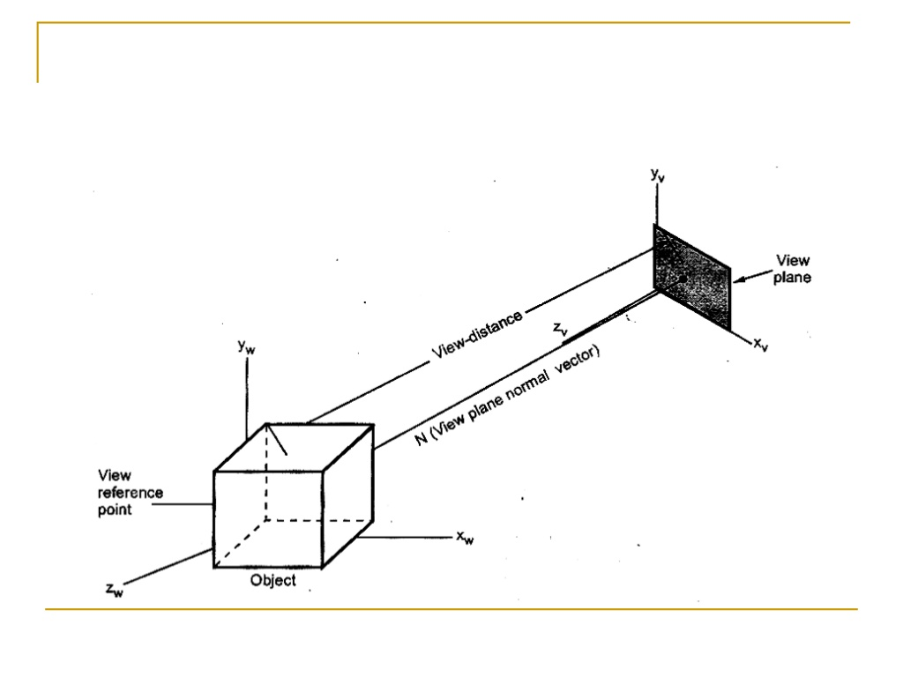

Slide 9
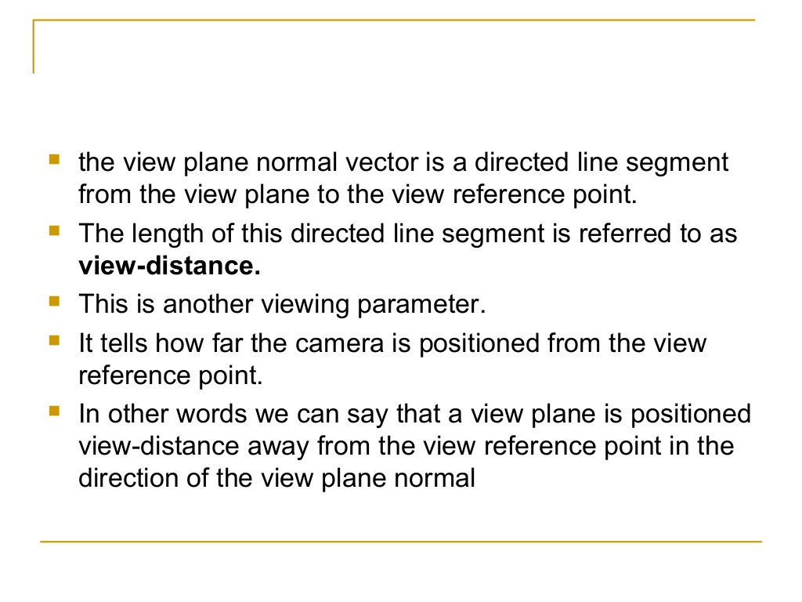

Slide 10
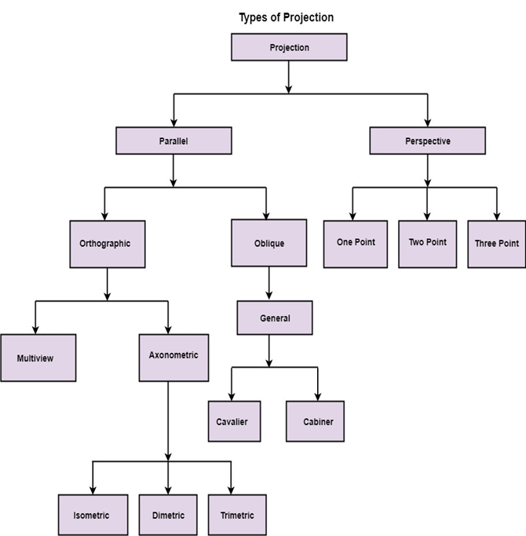

Slide 11
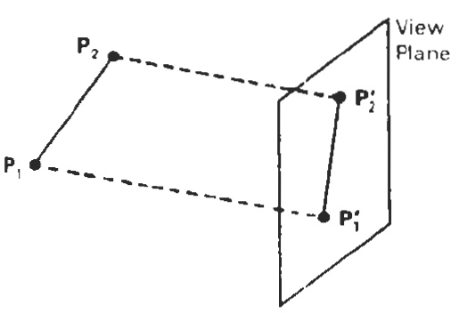
Projections
Once world-coordinate descriptions of the objects in a scene are converted to viewing coordinates, we can project the three-dimensional objects onto the two dimensional view plane.
There are two basic projection methods.
In a parallel projection, coordinate positions are transformed to the view plane along parallel lines

Slide 12
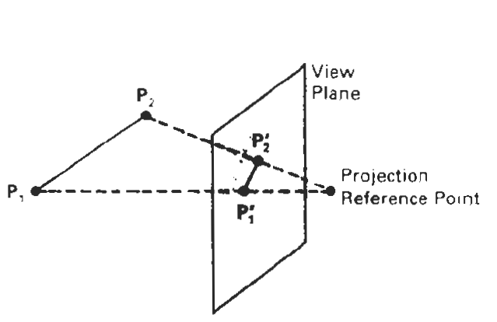
Projections
For a perspective projection, object positions are transformed to the view plane along lines that converge to a point called the projection reference point (or centre of projection).

Slide 13
A parallel projection preserves relative proportions of objects, and this is the method used in drafting to produce scale drawings of three-dimensional objects.
Accurate views of the various sides of an object are obtained with a parallel projection, but this does not give us a realistic representation of the appearance of a three-dimensional object.
A perspective projection, on the other hand, produces realistic views but does not preserve relative proportions. Projections of distant objects are smaller than the projections of objects of the same size that are closer to the projection plane.

Slide 14
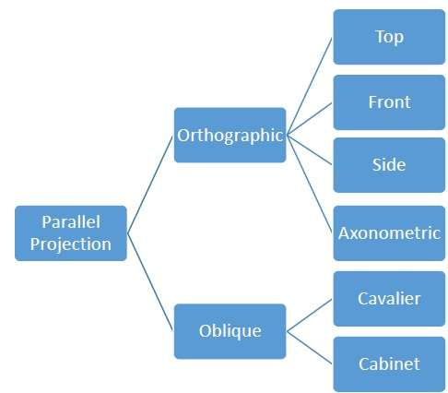
Parallel Projections

Slide 15
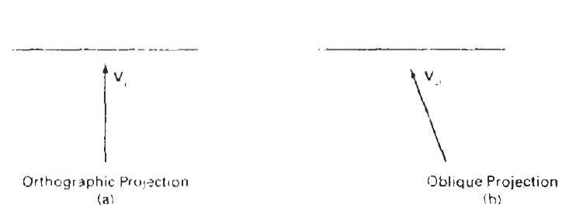
orthographic
When the projection is perpendicular to the view plane, we have an orthographic Otherwise, we have an oblique parallel projection.

Slide 16
Cont’d
Orthographic projections are most often used to produce the front, side, and top views of an object.
Front, side, and rear orthographic projections of an object are called elevators; and a top orthographic projection is called a plan view.
Engineering and architectural drawings commonly employ
these orthographic projections , because lengths and angles are accurately depicted, and can be measured from the drawings.

Slide 17
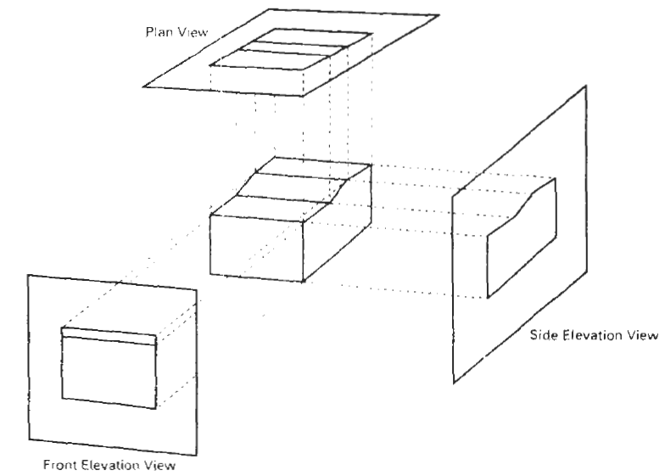
orthographic projections

Slide 18
We can also form orthographic projections that display more than one face of an object. Such views are called axonometric orthographic projections. The most commonly used axonometric projection is the isometric projection.
We generate an isometric projection by aligning the projection plane so that it intersects each coordinate axis in which an object is defined (called the principle axes) at the same distance from the origin.

Slide 19
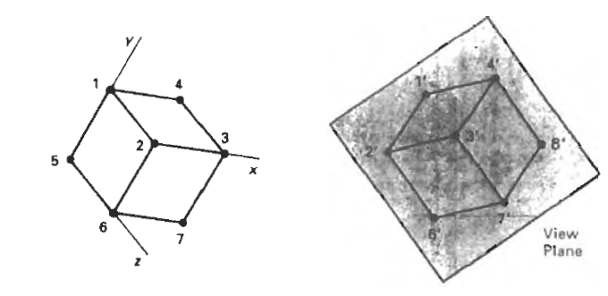
Isometric projection for cube
y
o
x

Slide 20
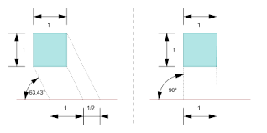
oblique projection

Slide 21
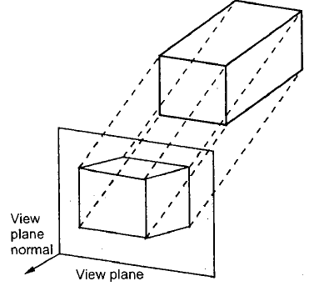

Slide 22
An oblique projection is obtained by projecting points along parallel lines that are not perpendicular to the projection plane.
Common choices for angle are 30 and 45, degree which display a combination view of the front, side, and top (or front, side, and bottom) of an object. views obtained are called cavalier projection.

Slide 23
When the projection angle is chosen 63.4 degree, the resulting view is called a cabinet projection. For this angle ,lines perpendicular to the viewing surface are projected at one-half their length.
Cabinet projections appear more realistic than cavalier projections because of this reduction in the length of perpendiculars.

Slide 24
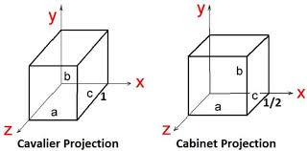

Slide 25
Perspective Projection
When a three-dimensional object is projected onto a view plane using perspective transformation equations, any set of parallel lines in the object that are not parallel to the plane are projected into converging lines.
The point at which a set of projected parallel lines appears to converge is called a vanishing point.

Slide 26
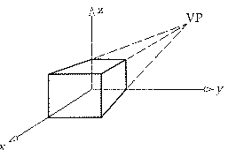
One point, 2 point and 3 point

Slide 27
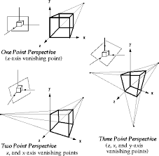

Slide 28


Slide 29
3D clipping
The window, which served as clipping boundary in two-dimensional space In three dimensional space the concept can be extended to a clipping volume or view volume. An algorithm for three-dimensional clipping identifies and saves all surface segments within the view volume for display on the output device. All parts of objects that are outside the view volume are discarded.

Slide 30
Clipping in three dimensions can be accomplished using extensions of two-dimensional clipping methods.
Instead of clipping against straight-line window boundaries, we now clip objects against the boundary planes of the view volume.

Slide 31
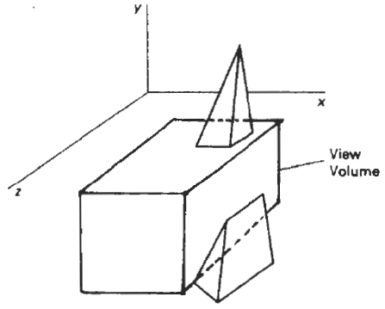
These volumes are six sided with sides: left, right, top, bottom, hither (near), and yon (far).

Slide 32
The two-dimensional concept of region codes can be extended to three dimensions by considering six sides and 6-bit code instead of four sides and 4-bit code. Like two-dimension, we assign the bit positions in the region code from right to left as
Bit 1 = 1, if the end point is to the left of the volume.
Bit 2 = 1, if the end point is to the right of the volume.
Bit 3 = 1, if the end point is the below the volume.
Bit 4 = 1, if the end point is above the volume.
Bit 5 = 1, if the end point is in front of the volume.
Bit 6 = 1, if the end Point is behind the volume.

Slide 33
Otherwise, the bit is set to zero. As an example, a region code of 101000 identifies a point as above and behind the view volume, and the region code 000000 indicates a point within the view volume.
A line segment can be immediately identified as completely within the view volume if both endpoints have a region code of 000000.
If either endpoint of a line segment does not have a region code of 000000, we perform the logical AND operation on the two endpoint codes.

Slide 34
If the result of this AND operation is nonzero then both endpoints are outside the view volume and line segment is completely invisible.
On the other hand. if the result of AND operation is zero then line segment may be partially visible. In this case, it is necessary to determine this intersection of the line and the clipping volume.

Slide 35
